Slide 1


TrustMark: Universal Watermarking for Arbitrary Resolution Images
Summary of the research paper by Tu Bui, Shruti Agarwal, and John Collomosse.
Prepared by: [Your Name]
by PAVAN ARAVAPALLI

Slide 2

Core Contributions
Novel Architecture
GAN-based model with frequency-aware loss for imperceptible watermarking.
Resolution Scaling
Supports watermarking images of any resolution via residual inference.
Watermark Removal Network
TrustMark-RM enables removal and re-watermarking of images.
State-of-the-Art Performance
Outperforms prior work in fidelity, robustness, and flexibility.

Slide 3
TrustMark Architecture Overview
Embedder (E)
Noise Module (N)
Extractor (X)
Embeds watermark into the image.
Simulates real-world image degradations.
Recovers watermark from distorted images.

Slide 4
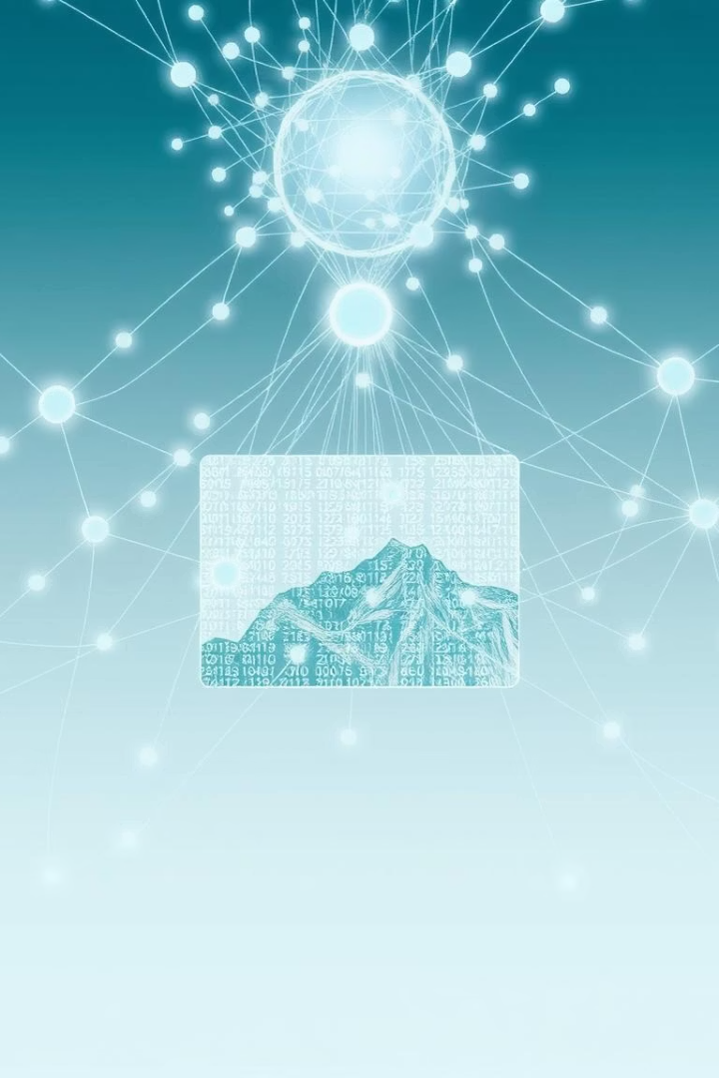
Embedder: Watermark Injection
Input: Image (256×256×3) and binary watermark.
Uses MUNIT-style network to fuse watermark into image features.
Output: Watermarked image.
Input
Process
Image and binary watermark data.
Interpolation and fusion via deep network layers.
Output
Watermarked image ready for use.

Slide 5

Extractor & Noise Module
Extractor (X)
Noise Module (N)
Training Flow
ResNet-50 with sigmoid output recovers watermark.
Geometric: crop, flip, resize
End-to-end learning with differentiable perturbations.
Photometric: JPEG, blur, brightness, contrast, Gaussian noise

Slide 6
Joint Training Loss Functions
Total loss balances quality and watermark recovery accuracy.
Quality Loss
Recovery Loss
YUV, LPIPS, FFL, GAN+GP components
Binary Cross Entropy for watermark accuracy.

Slide 7
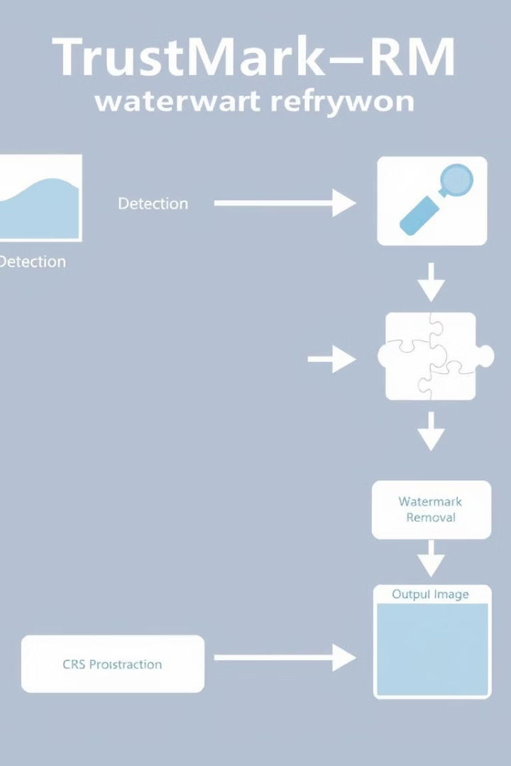
TrustMark-RM: Watermark Removal
Architecture
Function
Based on KBNet with denoising and attention mechanisms.
Removes watermark while preserving image realism.
Losses
Decoder Consistency
Adversarial Loss
MSE Loss

Slide 8
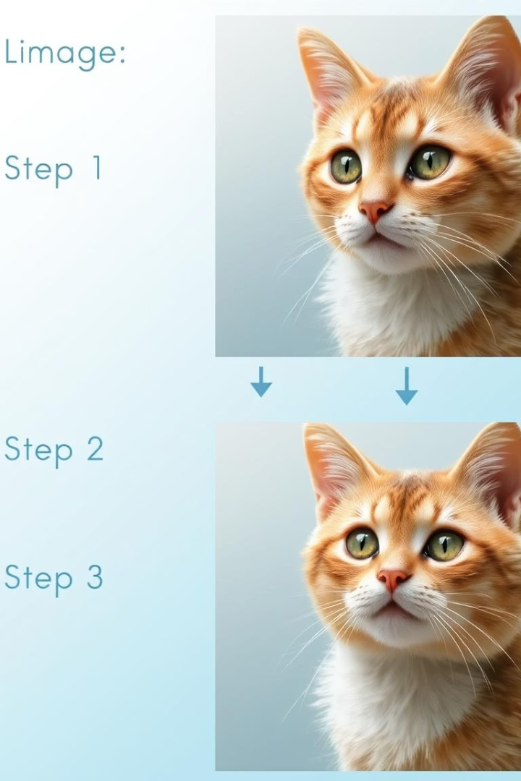
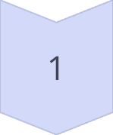
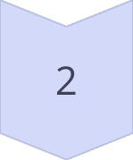
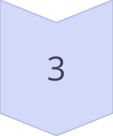
Resolution Scaling
Model trained at 256×256 but generalizes to any size using residuals.
Step 1
Resize image to 256×256.
Step 2
Apply TrustMark and compute residual.
Step 3
Upsample residual and apply to original image.

Slide 9

Final Output and Inference
Output is clamped sum of original image and interpolated residual.
Plug-and-play method works at inference time for any resolution.
Flexible
Supports arbitrary image resolutions.
Efficient
No retraining needed for different sizes.

Slide 10

Summary and Key Takeaways
Innovative Model
GAN-based watermarking with frequency-aware loss.
Versatile Scaling
Works on any image resolution via residuals.
Watermark Removal
TrustMark-RM removes watermarks preserving realism.
State-of-the-Art
Outperforms prior methods in fidelity and robustness.

